Slide 1
ECONOMIC STIMULUS IMPACTS
Bob Benton
David Frazier
Tory Young
Pani Maddi

Slide 2
ECONOMIC STIMULUS DASHBOARD
KEY METRIC 2
KEY METRIC 2
Unemployment Rate%
GDP

Slide 3
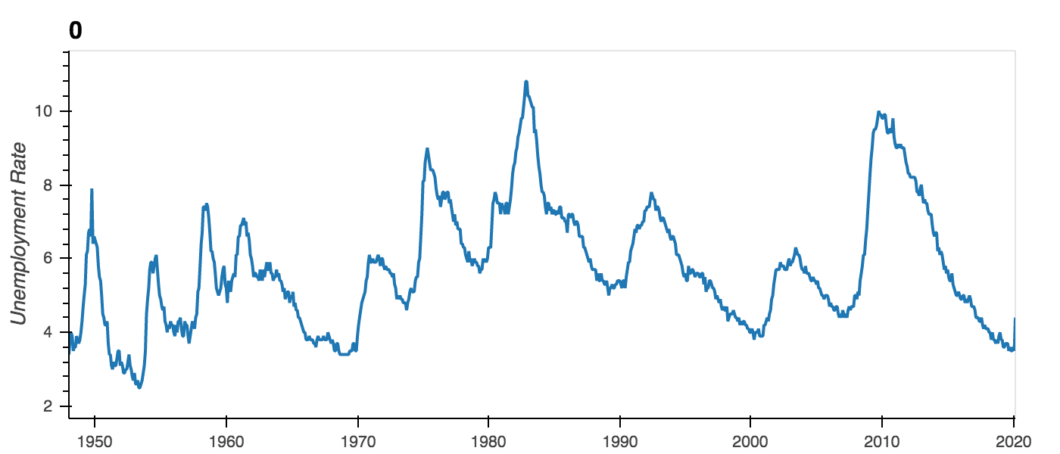
POTENTIAL IMPACT TO UNEMPLOYMENT
DROPDOWN 1
- PRE CRISIS PROJECTION
- POST CRISIS PROJECTION
CONFIDENCE LEVELS
- 95%
90%
80%

Slide 4
ECONOMIC STIMULUS
Why is the Economic Stimulus needed
Past Stimulus post 2008 financial crisis & how we measured it
Current criterion for Economic Stimulus
What could happen if there was no Economic Stimulus
What are some unintended consequences. How to prevent/minimize the unintended consequences

Slide 5
ECONOMIC STIMULUS
Why is the 2020 Economic Stimulus needed
Stabilization of the Economy
Protect Public Health that was impacted due to the coronavirus (COVID-19)
Insurance for U.S households and businesses

Slide 6
ECONOMIC STIMULUS
Past Stimulus post 2008 financial crisis & how we measured it
Unemployment was brought under control
Reduced the foreclosure rates
Provided liquidity to markets (ensure banks could continue to lend)
Bailed out several major institutions (banks, auto industry….)
Ensured GDP maintained and did not shrink
Measures/metrics
Foreclosure rates% (reduction)
Jobs created (increases)
Unemployment rate (reduction)
Stock market stabilization (enabled by QEs)

Slide 7
ECONOMIC STIMULUS
Criterion for Economic Stimulus
A stimulus package should generate growth and jobs to offset rising unemployment
A stimulus package should take effect quickly
A stimulus package should raise current deficits but not affect the long-term budget outlook
A stimulus package should target unmet needs.
A stimulus package should be fair.

Slide 8
ECONOMIC STIMULUS
Current criterion for Economic Stimulus (current total target - $2T)
U.S. Households (Consumers) – how much of the $2T
AGI (Adjusted gross income)
Small Businesses – how much of the $2T
List criterion
Individuals | Married Couples
<= $ 75k: $1,200 | <= $ 150k: $2,400
> $75k <= $99k: prorated | > $150k <= $198k: prorated
> $99k: no economic stimulus | > $198k: no economic stimulus
$500 per child? | $500 per child?

Slide 9
ECONOMIC STIMULUS
What could happen if there was no Economic Stimulus
Economy will be de-stabilized
Coronovirus rates and deaths would spike up
U.S households, states and businesses will collapse. Default on loans, mortgage payments, unable to take care of health. Unemployment, crime, fraud, overdoses would sky rocket.

Slide 10
ECONOMIC STIMULUS
What are some unintended consequences. How to prevent/minimize the unintended consequence.
 | Unintended Negative Impacts | Unintended Positive Impacts
 | People may get used to free money and not wanting to go back to work | Innovation from individuals, businesses
 | Businesses that don’t need the stimulus will get the money. Businesses that need the money will not get the money | Efficiency improvements in government and businesses
 | Adding to the already growing national debt (current debt $24.9T as of April 2020) | New technology adoptions (ex – telehealth services)
 |  | Goodwill of businesses

Slide 11
Current Stimulus
2008 stimulus impacts –
look at unemployment (FRED)
GDP (FRED)
Foreclosures (
CPI (consumer price index)
Inflation
2020 stimulus
unemployment
debt
GDP
Eviction stats
CPI;

Slide 12
Next Steps
Projections (assuming no Stimulus – based on historical/recent trend)
Get visualizations to work on the web
Census data for expense
Stimulus formula (think about what to include/exclude)

